Slide 1

MSIG: Data Transformation and Migration
May 2024

Slide 2
Data Migration Approach
Transform (Automated Transformation)
Load
Extract
GW Cloud
Data Load in Target Layer
Source System
Curated Layer
Azure
Data
Transformation
CMT_IN PMT_IN
GWCP
Data Audit
Validation & Data Cleansing Reports
Extraction of Source Data
Data Mapping
Load via
GW DUT
CMT_OUT PMT_OUT
Recon of Source
and Target
Recon Reports Stitch Backward
Extraction of Source Data
Understand the full target ecosystem.
Identification of Data.
Identify generic data patterns
Identify components that cannot be migrated.
Write common/reusable Extraction scripts.
Output: Content inventory and Data extracted as per agreed scope.
Data Mapping
Review/Modifications of standard templates.
Establish data lineage practices.
Update mapping document per Source system.
Review and freeze.
Output: Signed off mapping documents.
Data Cleansing
Ensure validity, completeness, duplicity and accuracy
Standardize the data at the point of entry.
Implement automated data cleansing tools.
Output: Cleansing rules and activities, clean data for Transformation.
Transform
Data Profiling/Data analysis post transform
Reconciliation and Verification.
Job automation
Ensure process efficiency
Reusable ETL frameworks
Output: Clean loaded and transformed data, success and exception reporting.
Recon and Validation
Recon between staging and target staging layer.
Reverse recon between target staging layer and target DB.
Validation of Migrated Data via Scoring rules of MSIG.
Output: Successful loaded/transformed data. Error reports.

Slide 3
DATA MIGRATION ACTIVITIES
EXTRACT
Copy of Prod DB, Mask PII data
Extract Data and Meta data from one or Multiple sources
Upload to Azure SQL
Establish connection between MSIG On prem and MSIG Azure via Azure SFTP Transfer or Site to Site VPN
Trigger Azure ADF Pipeline
Read Azure SQLand Store in Azure Datalake RAW format
Execute Source data Validation rules and push record to Error schema if any error
Transform source data by Leveraging Mapping sheet via Pyspark code
TRANSFORM
Store Transformed data in Curated DB
Execute Target data Validation rules and push record to Error schema if any error
Establish connection between MSIG Azure and GW Cloud via Azure Private link
Write Data to CMT_IN
TECHNICAL FEATURES
Reconciliation Report using Raw Data, Error, Curated Data, CMT_OUT
LOAD
Logging and Monitoring
Error and Exception Handling
Terraform script for Service Provisioning
Execute DUT and CMT job to pull data from CMT_IN located in MSIG Azure VM, and push to GW VPC CMT_IN and GW CC DB which is Aurora PostgreSQL
Retry and Revive
Truncate and Load Mechanism
Data , Service Security and access controls

Slide 4








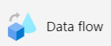

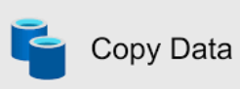
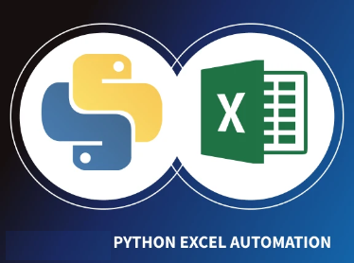

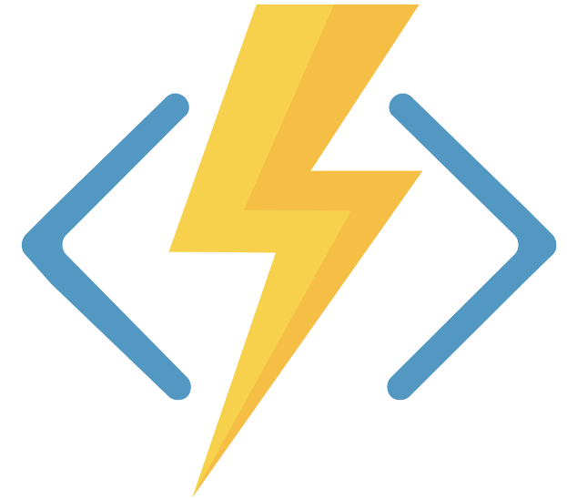





Data conversion for GW – Azure Architecture
MAPPING ANALYSIS
SOURCE
PREP,VALIDATE & TRANSFORM
TARGET
PLATFORM ADMIN
Schema Generation – Source & Target
Data Pipeline Orchestration – Azure Data Factory
Data Profiling
Metadata Ingestion Framework
Pipeline
Orchestration
Metadata Driven mapping
Data Quality
Configuration
Auditing & Error Handling
Reconciliation
Azure Monitor
Schema Profiling
Source DB
Target DB
ER Diagram
Implement data quality rules
Implement transformation tasks
Meta Data Driven
Logic Apps
Lookup Mapping
SQL Server(Ivos)
7
Assert
DUT Tool
Azure functions
CMTOUT
Security Centre
Excel-Python Automation
1
2
3
4
8
5
CMT Batch
6
Wins(MF)
1
Mapping /Build Status Reports
Raw Data
Validated Data
Transformed Data
Alerts
Storage
CMT IN
GW-CC
Azure SQL
Postgress – CMT_IN
Postgress- CMT_OUT
Data Wrangling
Schema/Data Profiling
Azure Data Lake
Azure Data Lake
Azure DevOps
Reporting
Data Quality Reports
Email Notification
Key Vault
Reconciliation reports

Slide 5
List of Automations Leveraged in Data Migration Tool
SmartMapper will be used to capture Source and target metadata and establish simple mappings.
Automation to read source metadata or Mapping file to generate DDLs for RAW layer and checked in the files in GIT repo. Later via CI/CD use those DDLs for higher env.
All source and target Technical validation rules should be auto generated by leveraging mapping sheet and saved in DB for execution.
All source and target business validation rules needs to be auto generated by leveraging mapping sheet and saved in DB for execution.
All ADF job source code(Pyspark) files will be auto generated by leveraging mapping sheet and checked in git repo.
All MASTER or lookup table of Target system should be provided by Platform and stored in a DB in key value pair.

Slide 6
MSMM Data Migration Tech Stack
Azure Subscription
Storage Accounts- Azure Data Lake Gen 2
Azure Data Factory
Power BI
Azure functions
Azure Databricks
Azure Blob
Logic apps
Azure Key vault
Azure Monitor
Azure PostgreSQL
Azure SQL Data Base
Networking Services (VNET , NSG, Private endPoints, Firewall, PrivateLink, Subnets)
Azure VM
Integration Service Environment

Slide 7

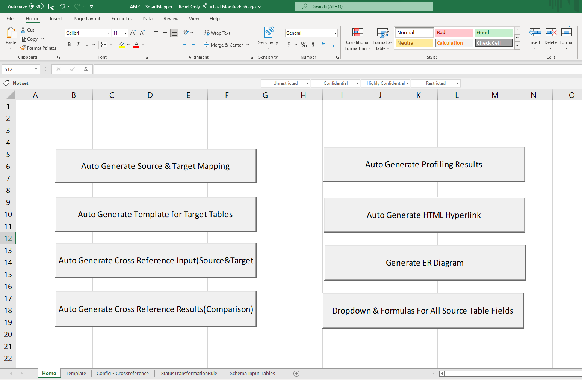
AMIC – Smart Mapper
Auto Generate Source schema & Target schema details (table/column name, data type, length, constraints, mandatory fields)
Auto Generate Data Profiling results (Duplicate rows, DISTINCT values, NULL check, Unique values, Correlation with other fields, Volume, Memory size)
Auto Generate ER diagrams (Key relationships and their columns)
Auto Generate Cross reference tables metadata mapping (Source & Target)
Auto Generate dropdown for mapping status & mandatory fields in mapping
Copyright © 2023 Accenture. All rights reserved.
7

Slide 8
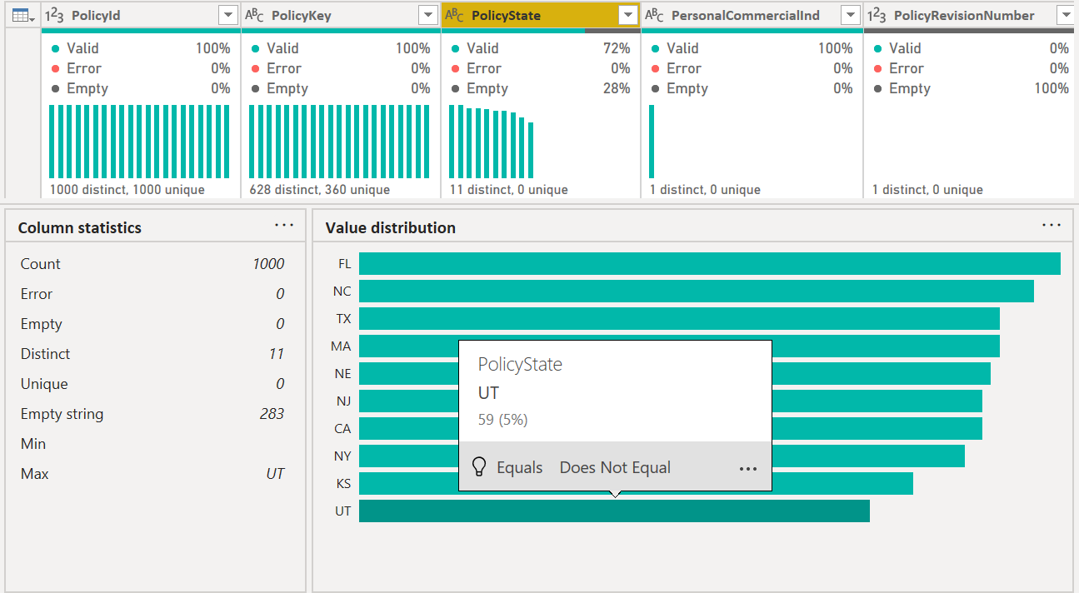
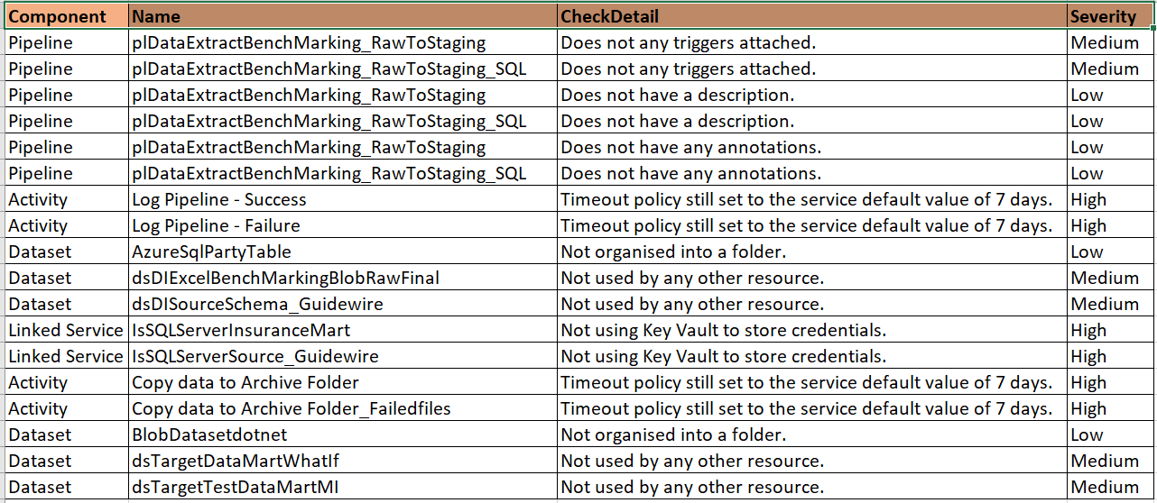
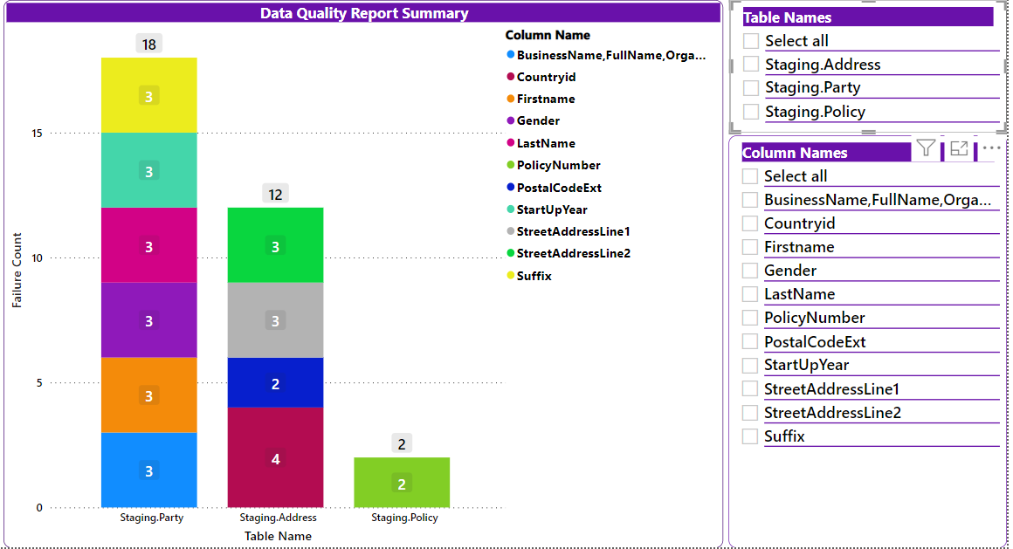
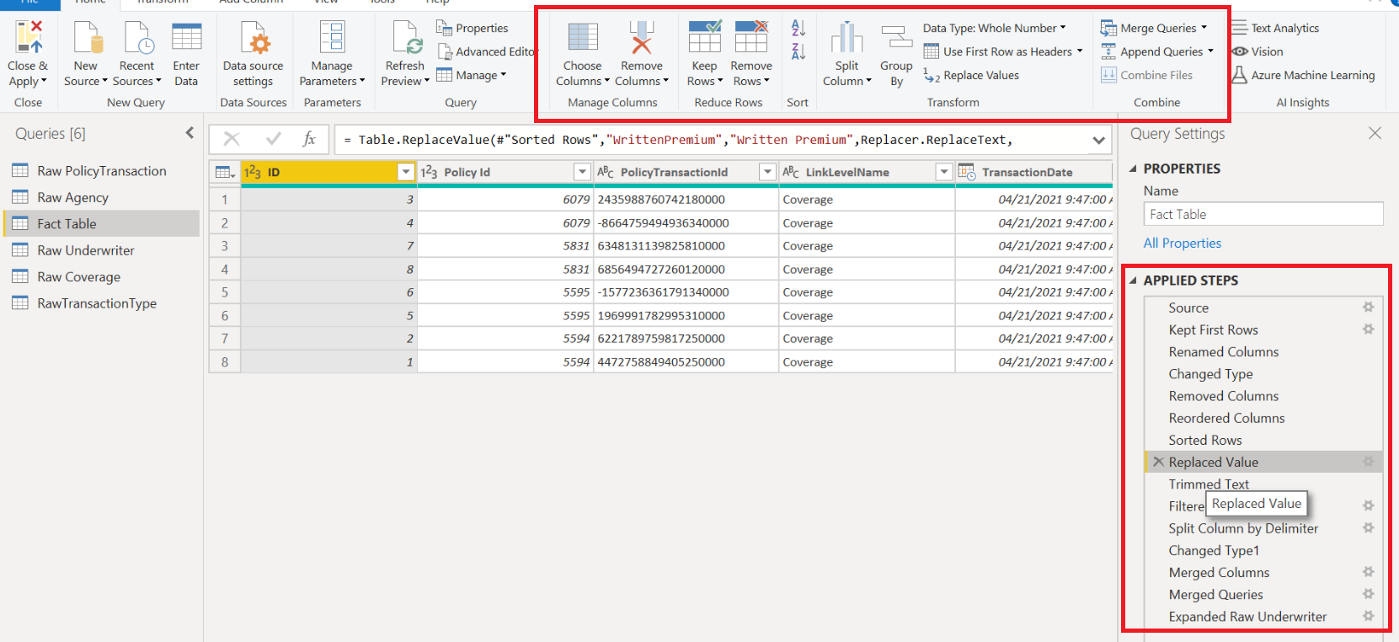
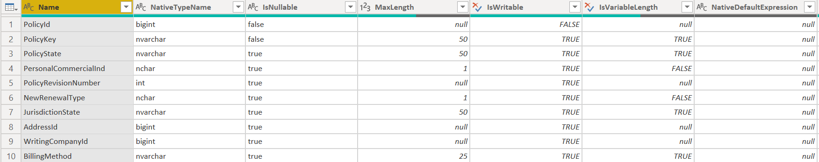
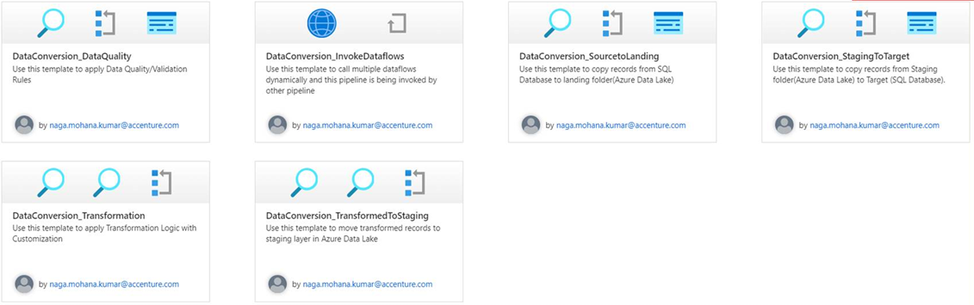
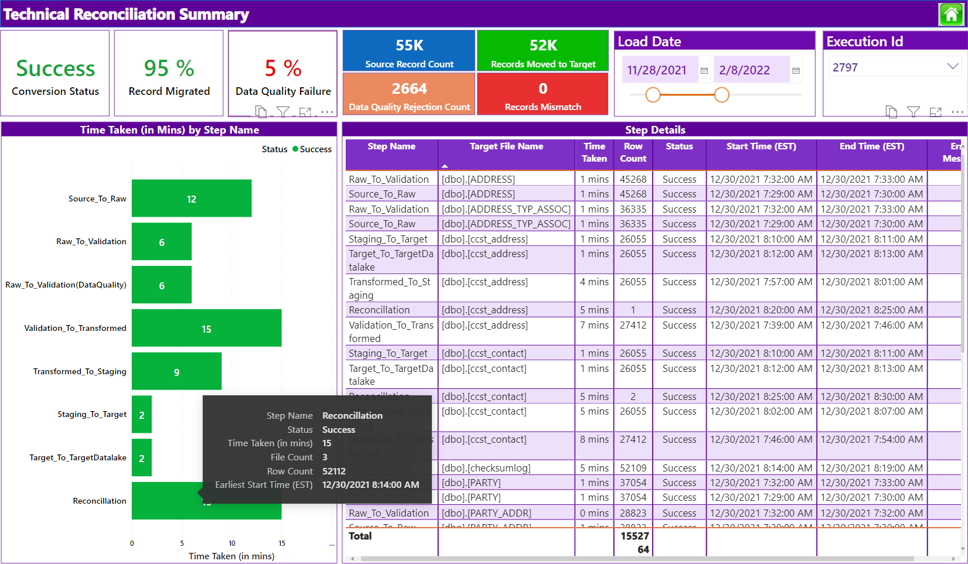
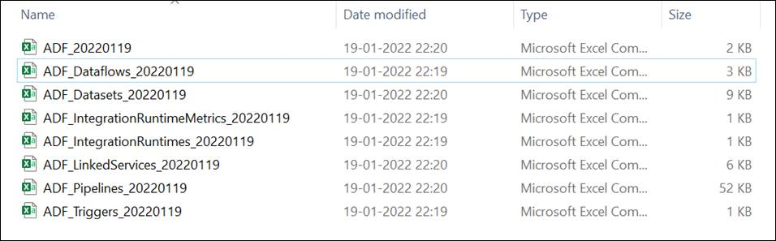
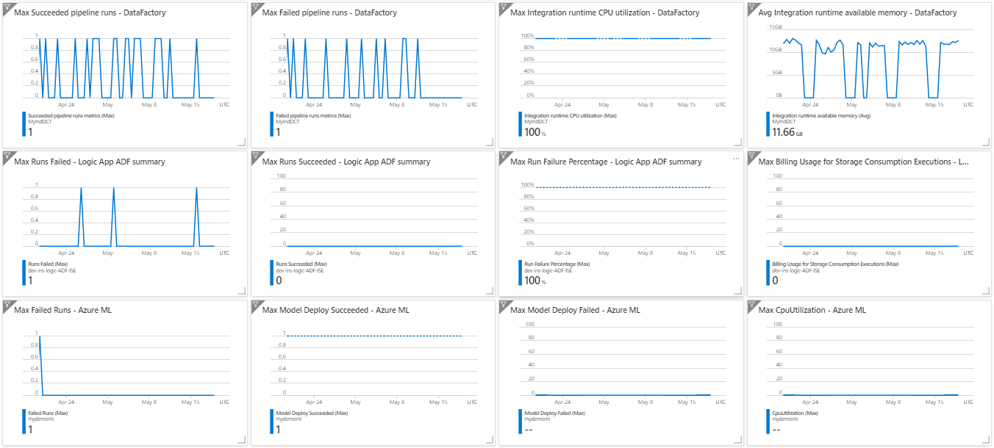
ADF – Accelerators To Optimize Quality & Increase Delivery Speed
Data & Schema Profiling
Code Quality Checker
Data Cleansing
Data Wrangling
Power BI - Provide intuitive ways to clean, transform, and understand data such as key statistics and distributions in Power Query Editor.
Scans all ADF objects and generates Code Quality results in excel sheet. This makes sure that all team members are enforcing the naming conventions and best practices.
Reports generated on top of records where Data Quality rules failed. Both summary & detailed view available
Power BI - Involves piecing raw data together and understanding the business context of data like merging multiple data sources into a single dataset for analysis.
Re-usable Templates
Technical Reconciliation Report
Automatic Documentation
Continuous Monitoring
Different organizations have similar data integration needs and require repeat business processes.
Improve developer productivity along with reducing development time for repeat processes.
Reconciliation reports with all auditing and error details available which includes % of Data Quality failure,% of records migrated successfully, error messages in case of any failures
Automation scripts will scan all ADF objects and generates them in excel format where we can use this as technical design document instead of manually preparing one and updating for each iteration/development changes.
Azure Monitor helps you maximize the availability and performance of your applications and services.
This information helps you understand how your applications are performing and proactively identify issues affecting them and the resources they depend on

Slide 9
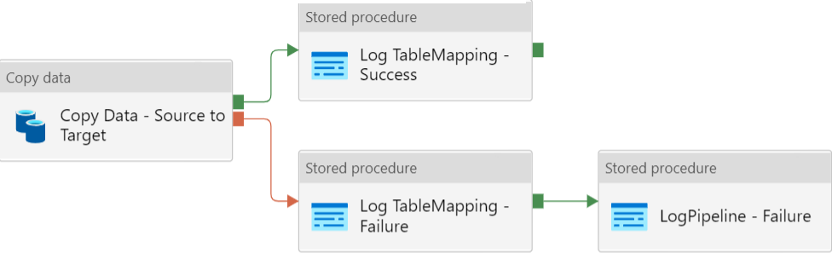
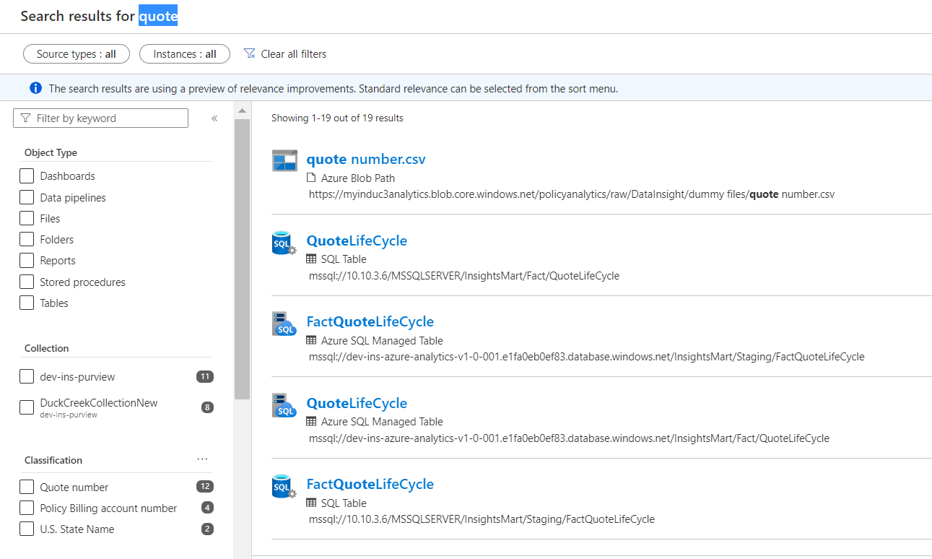
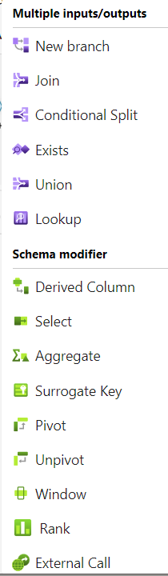
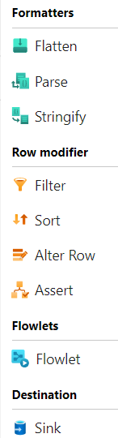
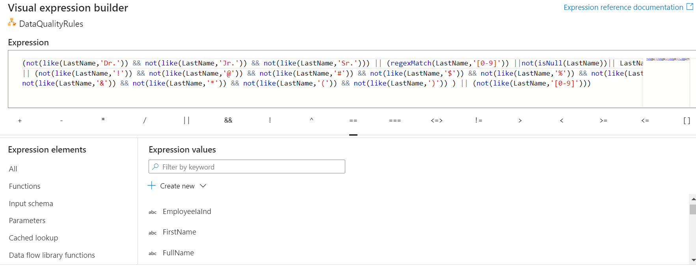
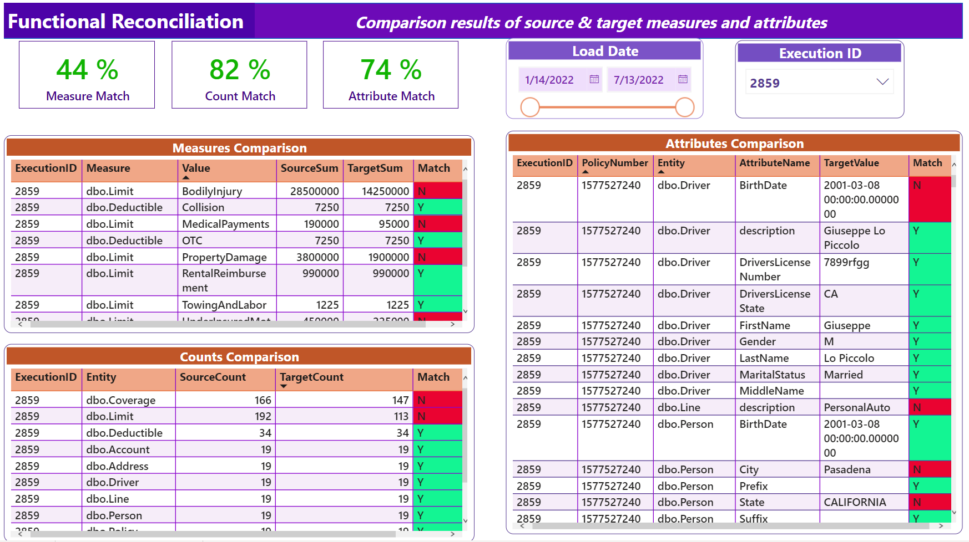
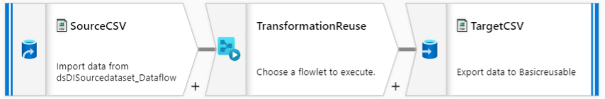
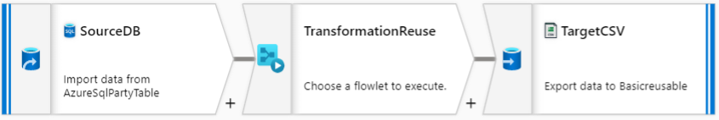
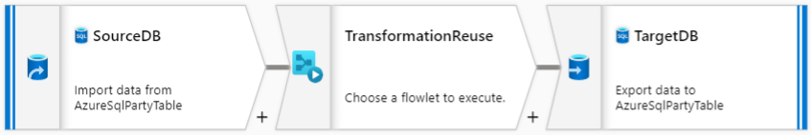
ADF – Accelerators To Optimize Quality & Increase Delivery Speed
Copy Data – Configuration Driven
Data Discovery & Classification – Multiple Sources
No Code Transformation in ADF
Enable Business Analyst/Data engineers to access trustworthy data from multiple sources and benefit from the automated classification by Purview
Using this framework, data/files can be copied from source server to target server with no code. Only metadata configuration is required
No code Data Quality Rules in ADF
Functional Reconciliation Report
Visual build your Data Quality Rules using Assert transformation in ADF. This will help to determine if each row/column value in your data meets a set of criteria. It also allows you to set custom error messages when data validation rules are not met
Reusable ETL logic
Create reusable portions of data flow logic that you can share in other pipelines as inline transformations. Flowlets enable ETL jobs to be composed of custom or common logic components
Below results are generated as part of existing functional reconciliation process:
Simple record counts check for each table to keep track of whether the targeted number of records have migrated or not
Compare SUM of measure fields between source and target
Compare individual transactions between source and target
Mapping Data Flow - Visually designed data transformations which allows data engineers to develop data transformation logic without writing code. The resulting data flows are executed as activities within Azure Data Factory pipelines that use scaled-out Apache Spark clusters.

Slide 10
Technical Reconciliation Report
Functional Reconciliation Report
Below results are generated as part of existing functional reconciliation process:
Simple record counts check for each table to keep track of whether the targeted number of records have migrated or not
Compare SUM of measure fields between source and target
Compare individual transactions between source and target
Reconciliation reports with all auditing and error details available which includes % of Data Quality failure,% of records migrated successfully, error messages in case of any failures
Gates 1, 2, 3 Balancing Reports metrics
Total number of policies Total number of Claims Total number of Claims by LOB Total number of Claims per Status Total number of Claims per segment Total amount of the payment per claim Total amount of the reserve per claims | Total amount of payment Total number of coverages Total number of Sub coverages Total number of roles Total number of incidents Total number of exposure per claim Total number of Riskunit per claims Total amount recovery per Claim Total amount of the recovery reserve per claim

Slide 11
Data Migration Security Considerations
Infra Security
Native Services Security
Data Security
IP firewall rules
Virtual Network rules
Microsoft defender
NSG and ACL
Azure Data in REST – transparent encryption of data at rest and keys will be custom keys
Azure Data in transit - TLS1.2 certificates to be installed
Azure key vault – Encryption with keys (with rotation)
Role based access to services - Azure AD and Azure RBAC
Encryption at REST (KMS, AES 256)
Encryption in Transit
(TLS1.2)
Data Anonymization/ Masking
Encryption with PGP

Slide 12
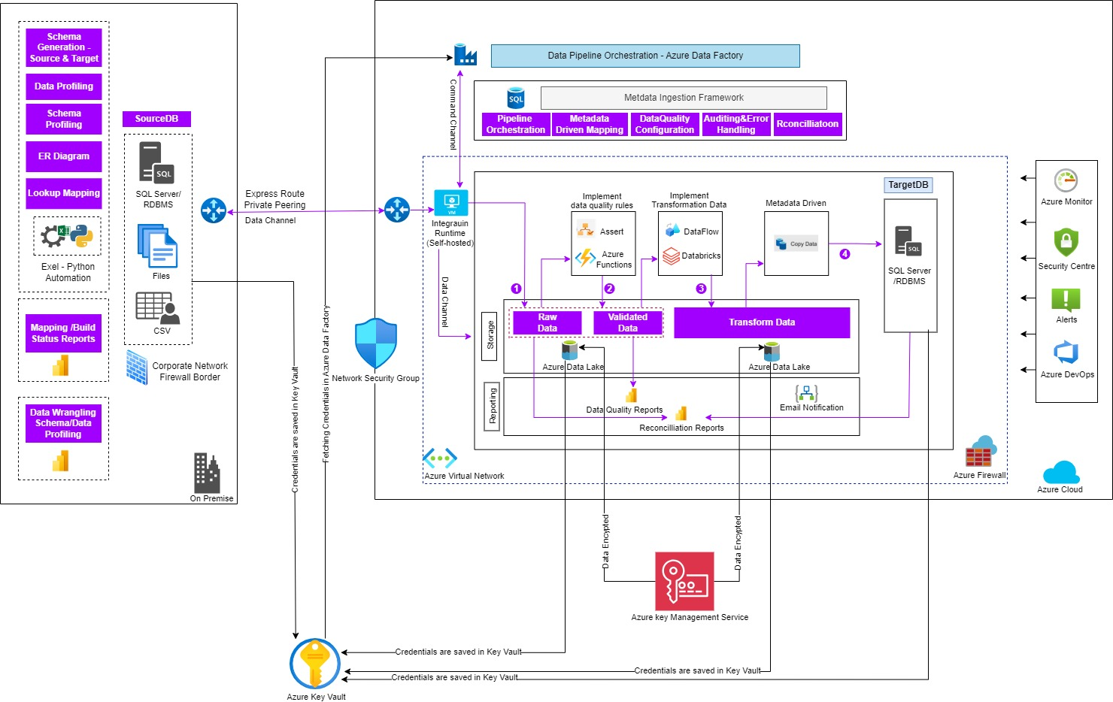
MSMM Data Migration Data and Azure Native Service Security

Slide 13
Solution Assumptions – Responsibilities Breakup
Extraction
Pre-Processing
Data Quality
& Profiling
Data
Transformation
Load Ready Tables
Loading & Reconciliation
Data Cleansing
File Format Validation
Data Mapping Rules
Audit Control Tables
Functional Validation
DQ Rules
PII Masking
Audit Control Totals
Transformation ETLs
Transformation Validations
Premium Validation
DQ Reports
Data Extraction Rules
DQ Feedback / Fixes to Source
Value Mapping
Error Handling and Reporting
Regression Testing
Files Staged on Folder
Error Handling and Reporting
Downstream and E2E Testing
User Acceptance Testing
Workers comp
Claims Graph
Accounts
FNOL
Coverage
Incidents
Payments
Subject Areas
WC Claims
Subrogation
Litigation
Payment , Reserves, Recovery
Claim Notes, Comments and Activities
Accenture
MSIG
Notes:
Optional for RC4

Slide 14
Potential Benefits Expected
Accenture Cloud Based Data Migration Tool
FASTER SPEED TO MARKET – Accenture POC
Production Go Live - Migration of 200K Claims
Pay as you go model (no license cost) – Cloud Native Services – 30 to 40% of saving in comparison with Traditional ETL License cost.
Reusability – Reuse from Accenture asset repository, Guidewire tool sets (CMT, PMT and DUT) for GW Cloud Data Migration
Cheaper implementation - Accenture GW COE’s Trained and GW and AWS certified resources. ATCI driven
Synergy with Platform – Complex transformations can be done only by synergy between platform team and technology vendor and customer.
Eco system interlock – Azure cloud services for Data Migration, Data Lake, Platform, Reporting.
Well Architected Framework – Synergy between Microsoft and Accenture
Traditional Data Migration Tool
License Cost
High implementation cost – Onshore driven
Less Reusability – Start from scratch
Up to 50%
30 to 40%
80%
20 to 30%
30%
Reduction in Conversion processing time
(Multithreading capability, elasticity)
Cost Savings in Migration ( Reusability of POC, automation of validation rules, Target mapping 100% reusability)
Automated Process with No Human Touch
(Notification, Realtime and batch execution)
Testing Effort Reduction due to Automated Testing
(GT Testing will be enabled including value testing)
Overall Savings on end to end Migration

Slide 15
THANK YOU

